Slide 1
Sports Injury, Rehabilitation & Return-to-Play Management System

Slide 2
SportsCare is a web-based Sports Injury, Rehabilitation and Return-to-Play Management System. It helps coaches, physiotherapists and administrators record injuries, plan rehabilitation, follow treatment and decide when an athlete is ready to play again.
Introduction
Who uses it
Admin, Coach and Physiotherapist. Each role gets its own access and screens.
What it manages
Injuries, rehabilitation, treatment, appointments and reports for every athlete.
How it is built
Made with HTML for the layout, CSS for the design and JavaScript for the logic. Records are saved in the browser's local storage.
2
Notes:
Say what the project is and who will use it.

Slide 3
In many sports teams, injuries are written on paper or in separate spreadsheets. Because of this, it is hard to follow an athlete's recovery, share details between coaches and physiotherapists, and be sure the athlete is ready to play again. Missed follow-ups and an early return to play can make the injury worse.
Problem Statement
Scattered records
Injury details are kept in many different places.
Unclear progress
Coaches cannot easily see how rehab is going.
Unsafe returns
Athletes may go back to play before they are ready.
3
Notes:
Read the statement slowly, then explain the three problems.

Slide 4
PROBLEM
Scattered records
→
One central portal
All athlete, injury and treatment records are stored and searched in one place.
Our Solution
PROBLEM
Unclear progress
→
Clear rehab tracking
Exercise checklists, progress bars and timelines show recovery at a glance.
PROBLEM
Unsafe returns
→
Safe return checklist
A readiness checklist and physiotherapist-only clearance protect the athlete.
4
Notes:
Match each problem with the feature that solves it.

Slide 5
Project Objectives
1. Keep records in one place
2. Plan the rehabilitation
3. Track the treatment
Store athlete details, injury history and treatment so nothing is lost or repeated.
Give every injured athlete an exercise plan with a daily checklist and progress bar.
Note treatment plans and follow-up dates so that no visit is missed.
4. Check readiness
5. Help teamwork
6. Give clear reports
Use a simple checklist to judge whether an athlete is fit to return to play.
Let coaches, physiotherapists and admins work together with the right access for each.
Show charts and reports that can be printed or saved as a file.
5
Notes:
Explain the six goals in simple words.

Slide 6
Technologies Used
Technology | Used for
HTML5 | Page structure: login, forms, tables and pop-up windows
CSS3 | Colours, layout, dark mode and the charts
JavaScript | Working logic: roles, checks, reminders and reports
Local storage | Saves all records inside the browser
VS Code + Live Server | Writing the code and testing it
sportscare
6
Notes:
Each technology has one clear job in the project.

Slide 7
System Architecture
Admin
Coach
Physiotherapist
Presentation layer
HTML and CSS. Login page, sidebar, forms, tables, charts and pop-ups.
Logic layer
JavaScript. Role checks, validation, reminders, reports and clearance rules.
Data layer
Local storage. Athletes, injuries, plans, assessments and appointments.
↔
↔
How one action flows through the system
1 User clicks
2 Role is checked
3 Data is updated
4 Saved in storage
5 Screen refreshes
7
Notes:
Three layers: what the user sees, the logic, and the saved data.

Slide 8
System Modules
Dashboard
Athletes
Injuries
Statistics, charts and reminders
Profiles and injury history
Complete injury records
Rehabilitation
Treatment
Return to Play
Plans and daily checklists
Plans and follow-up dates
Readiness assessment
Appointments
Reports
Settings
Book, edit and cancel
Print and CSV export
Profile and dark mode
8
Notes:
Nine pages cover the whole journey from injury to return.

Slide 9
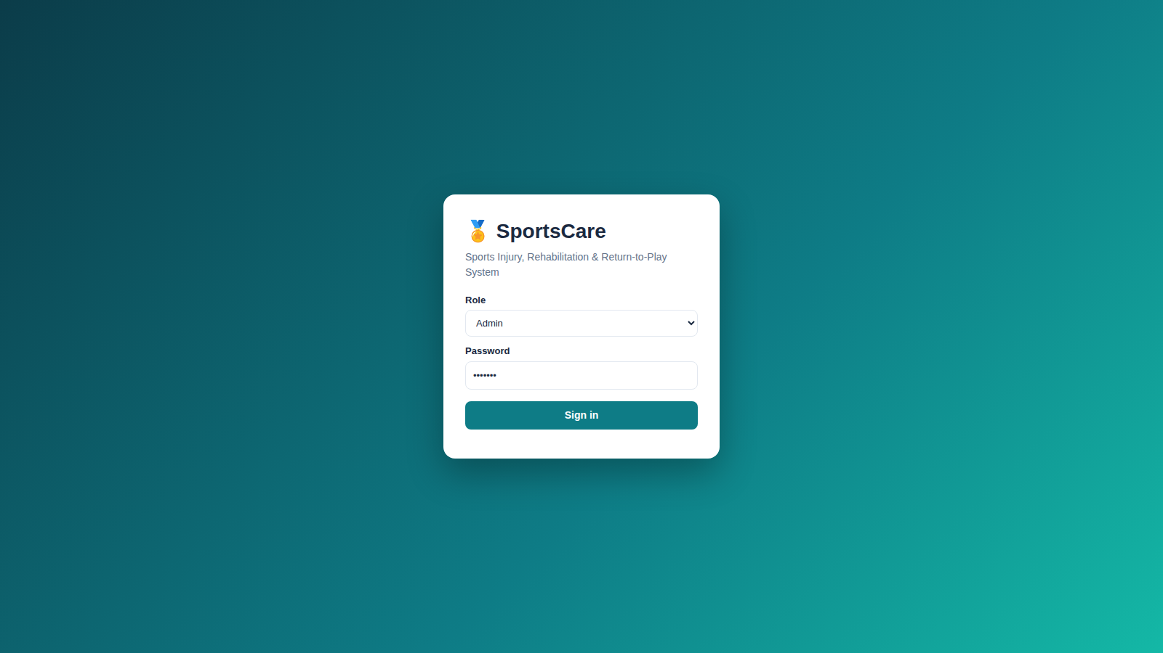
Login and Role-Based Access
Feature | Admin | Coach | Physio
Manage athletes | Yes | Yes | View
Manage injuries | Yes | Limited | Yes
Rehab and treatment | View | View | Yes
Clear for play | No | No | Yes
Appointments | Yes | Yes | Yes
Delete records | Yes | No | No
Admin, Coach and Physiotherapist each see different data and actions.
9
Notes:
Mention clearly that this login is only a demonstration.

Slide 10
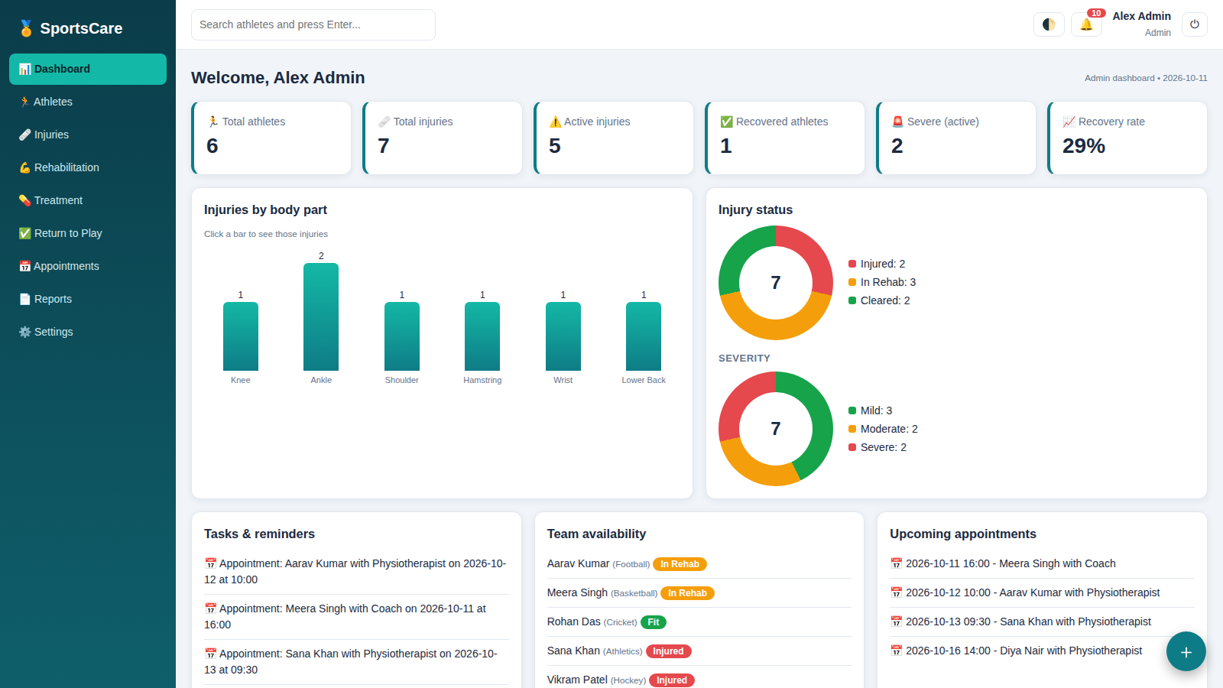
Dashboard
Six statistic cards
Bar chart by body part
Status and severity charts
Reminders and recent activity
10
Notes:
Show the statistics and click one bar of the chart.

Slide 11
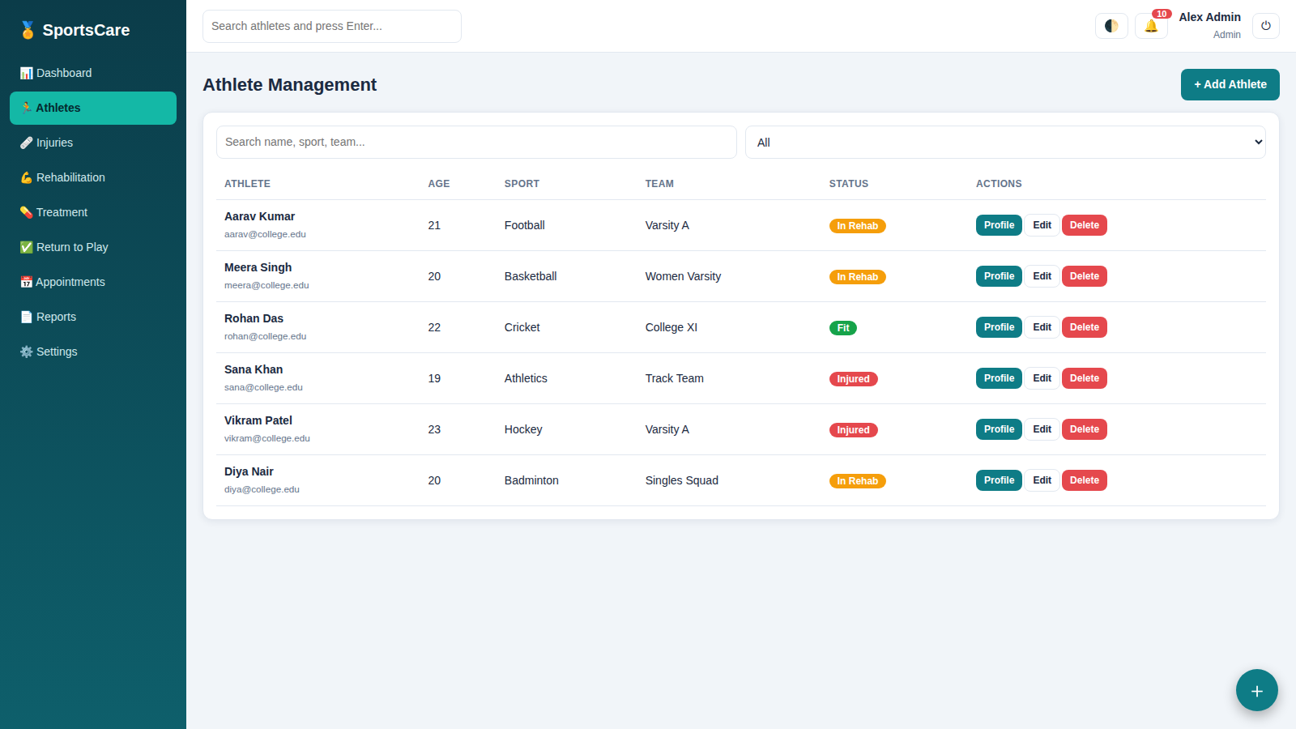
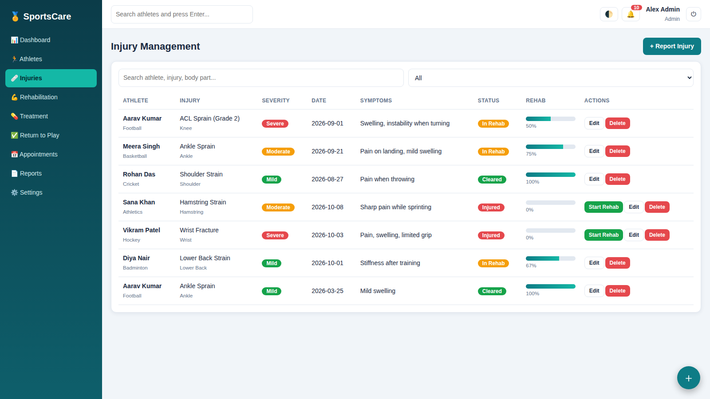
Athletes and Injuries
Athletes: add, edit, delete, search, filter and open profiles
Injuries: body part, severity, symptoms, treatment and status
11
Notes:
Add, search and open a profile.

Slide 12
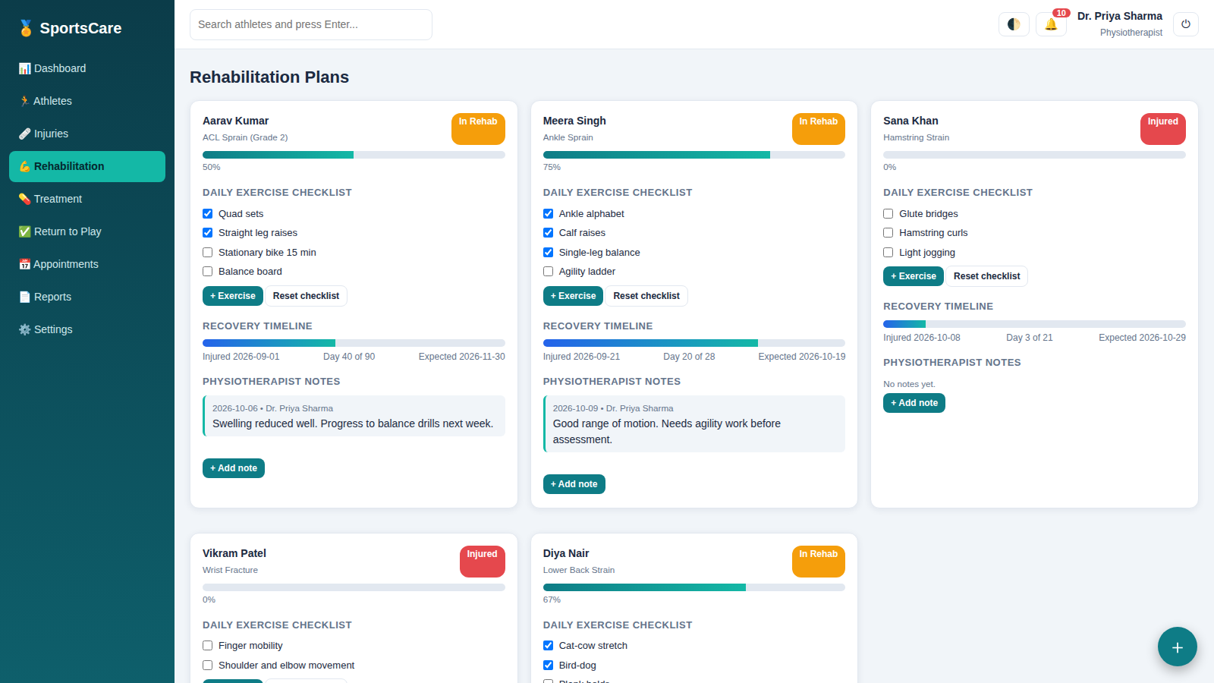
Rehabilitation and Treatment
Exercise plan for each athlete
Daily checklist and progress bar
Recovery timeline
Physiotherapist notes
Follow-up dates with alerts
12
Notes:
Tick an exercise and the progress bar moves.

Slide 13
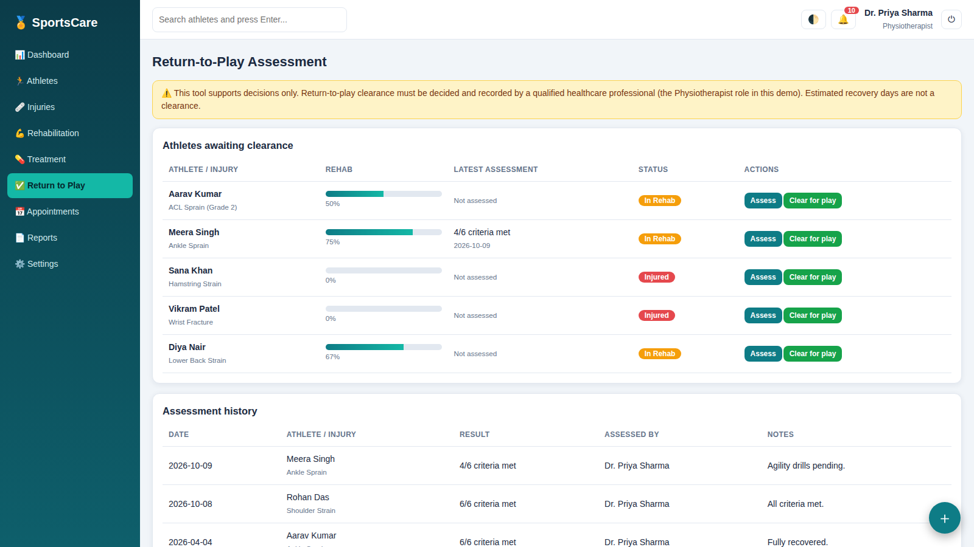
Return-to-Play Assessment
1
Rehab plan reaches 100%
2
Six-point readiness checklist
3
Physiotherapist confirms
4
Athlete is marked as cleared
Safety rule: medical clearance is always a decision for qualified healthcare professionals. Only the Physiotherapist role can record it.
13
Notes:
Stress that a qualified professional makes the final decision.

Slide 14
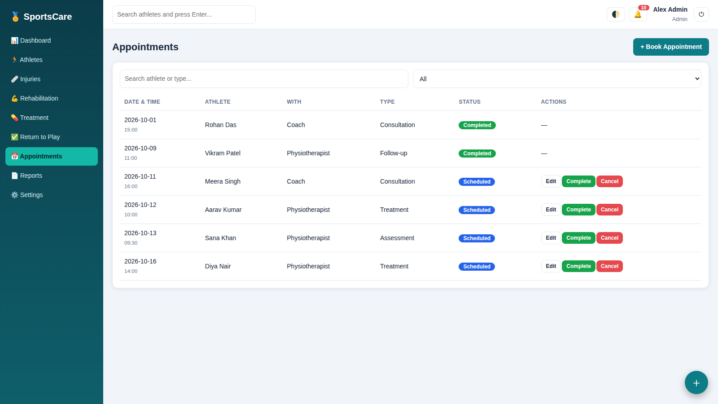
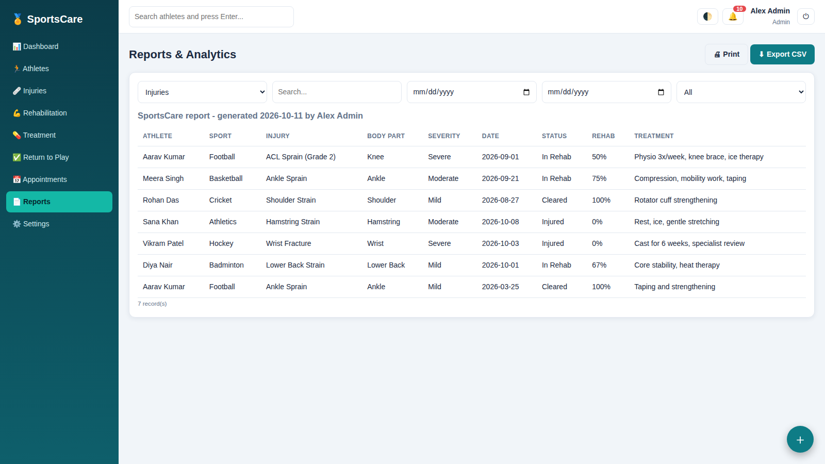
Appointments and Reports
Appointments: schedule, edit, complete and cancel
Reports: search, date filters, print and CSV export
14
Notes:
Appointments can be edited or cancelled; reports can be printed or exported.

Slide 15
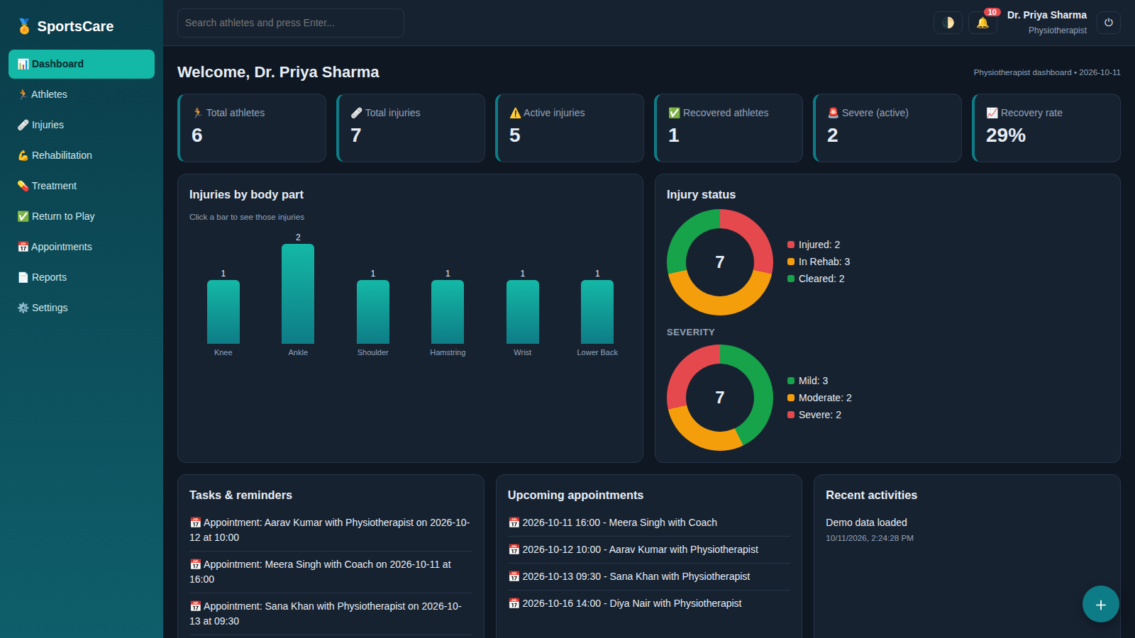
Notifications and Extra Features
Reminders for appointments, follow-ups and rehab tasks
Dark mode with one click
Quick-action menu
Profile settings
Recent activity list
Works on tablets and phones
15
Notes:
Dark mode and reminders make it feel like a real application.

Slide 16
Data Storage and Security
How data is saved
Limitation
What a real system needs
Records are stored in the browser's local storage, so they stay after the page is refreshed. Sample data is added so the dashboard is not empty.
The login is only for demonstration and is not secure. Anyone using the same browser can read or change the saved data.
A backend server, a proper database, encrypted passwords, secure sessions and role checks done on the server.
16
Notes:
Be honest: this demo login is not secure.

Slide 17
Future Scope
Step 1
Step 2
Step 3
Backend and database
Smart reminders
Data and mobile
Add a server with secure login so many users can work together.
Send email and SMS alerts for appointments and follow-ups.
Connect wearable data and build a mobile app for athletes.
17
Notes:
Three steps to turn this into a real product.

Slide 18
Conclusion
What we built
A complete web portal with nine modules covering injuries, rehabilitation, treatment, appointments and reports.
What it achieves
Records stay organised, rehab progress is easy to see, and return to play follows a clear checklist.
What we learned
Planning a project, building forms and dashboards, handling user roles and thinking about safety.
SportsCare shows that a simple, well-organised system can make injury recovery safer for student athletes.
18

Slide 19
Thank You

